Slide 1
Tackling Range Operations
HackerTalks 2018, Delta Force

Slide 2

What’s a Range Operation ?

Slide 3
Let’s just start with an example

Slide 4

Given an array A[1..N]
Q queries
Each query consists of L and R
Give me the sum of A[L..R]

Slide 5

Let’s brute our way through

Slide 6
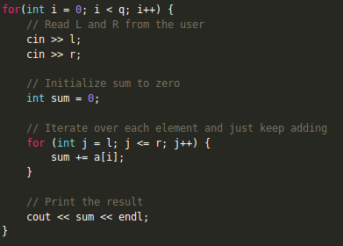
Here’s the code :) Pretty simple.

Slide 7
Yaay!!
Problem solved, right?
Umm. Not really.

Slide 8
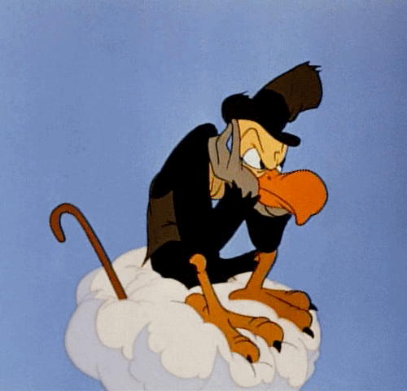
Takes way too much time for a large input

Slide 9

Let’s try a different approach

Slide 10
Well, we need to compute range sums, right?
Then let’s try something along those lines

Slide 11
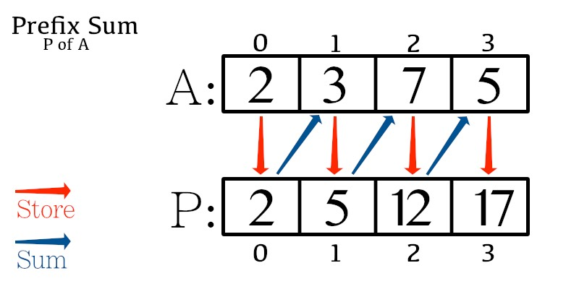

Slide 12
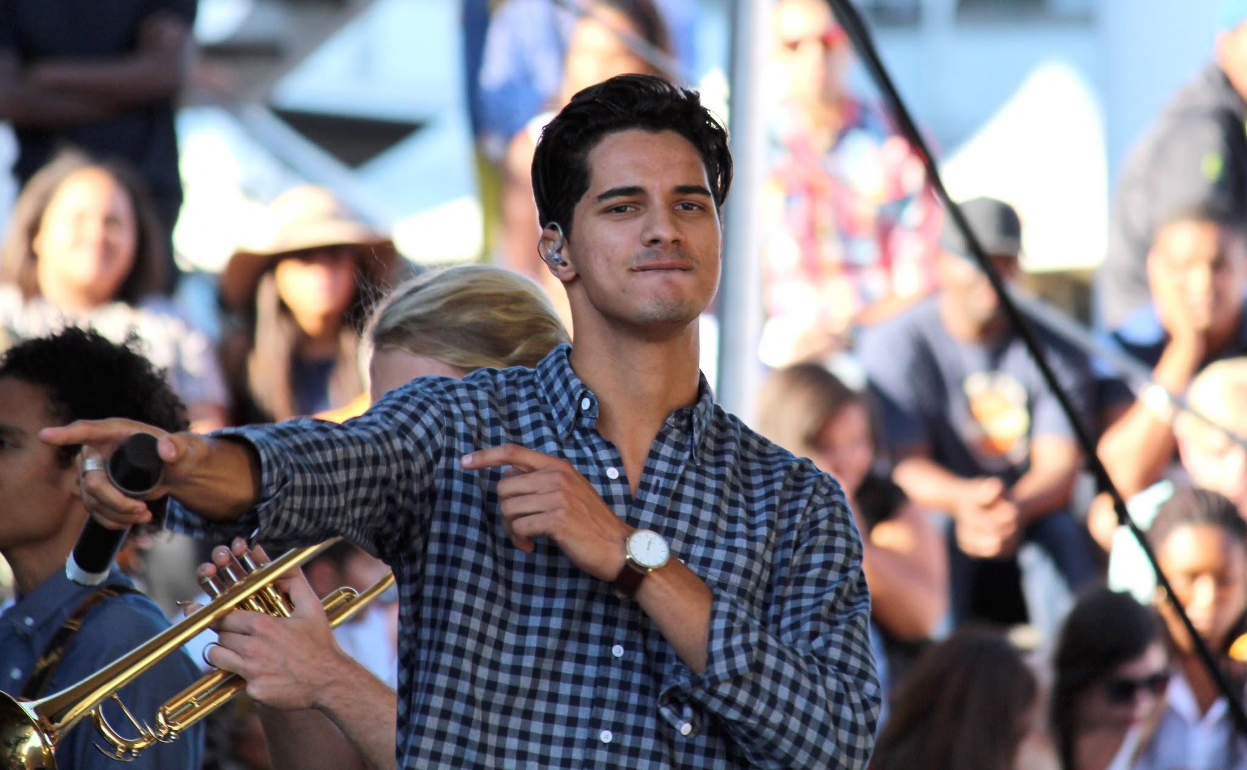
Prefix Array
P[i] = sum(A[0..i])
sum(A[L..R]) = P[R] - P[L-1]

Slide 13
Time to celebrate :)
We just answered queries in constant time
Can’t get better than this

Slide 14

Let’s add a small twist to the question now

Slide 15
Two types of queries:
Type 1 : Given L and R, return sum(A[L..R])
Type 2: Given Pos and Val, update A[pos] = Val

Slide 16

What do we do now?

Slide 17

Let’s modify our Prefix Array approach
So, what’s causing our
updates to take so long?

Slide 18
Dependent right till beginning of the array
This is just sad :(
Let’s do something about it

Slide 19
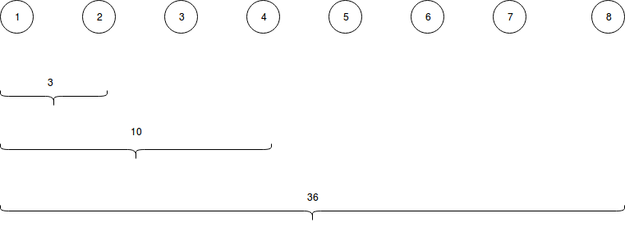
Updates look much better now.
But looks like we traded off on queries.

Slide 20
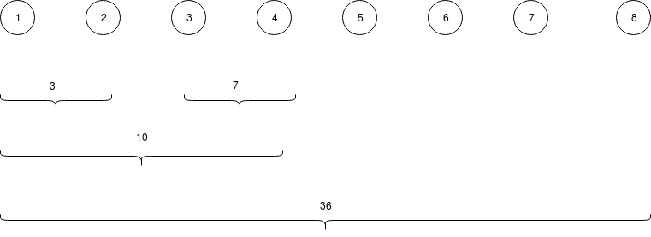
That’s slightly better, isn’t it?

Slide 21
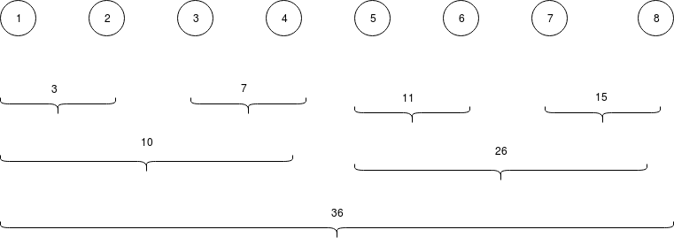
THIS IS IT

Slide 22
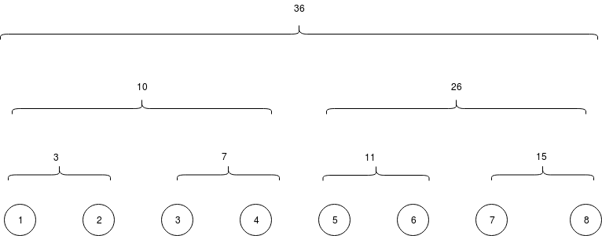

Slide 23

Behold. This is nothing but what we call a Segment Tree.

Slide 24
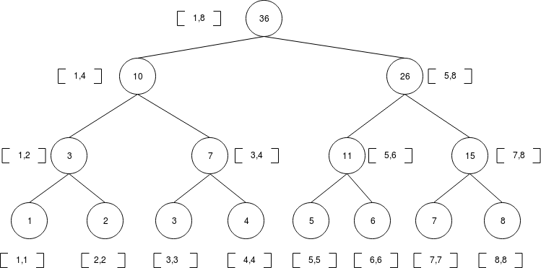
So, this is what it looks like

Slide 25
Phew.
That was a lot of work.
Did it pay off?
How many steps do we take now to find the answer?

Slide 26
Let’s see a demo
of how the
update and query
actually works.

Slide 27
Hmm.
This is fine, but where do I apply this?
And most importantly, how?
Will it always be this simple?

Slide 28
Given a sequence A₁, A₂, ..., A_{N}
Q queries
In each query, you are given two parameters L and R
You have to find the smallest integer X such that 0 ≤ X < 2³¹ and the value of (A_{L} xor X) + (A_{L+1} xor X) + ... + (A_{R} xor X) is maximum possible.

Slide 29
Let’s brush up on XOR first
1101 xor 1010 = 0111
Identical bits ---> 0
Complementary bits ---> 1

Slide 30
Basic objective:
11001 xor ????? = 11111
????? = Bitwise complement of 11001 = 00110

Slide 31

a_{i} 1101 1101 1110
X_{i} 0010 0010 0001
But we need to choose a common X :(
Ross Chandler Joey

Slide 32
So what do we do??
Let’s be greedy (and kind)
Choose bits to maximize the number of happy guys

Slide 33
a_{i} 1101 1101 1110
X_{i} 0010 0010 0001
X = 0 0 1 0
R,C,J R,C,J R,C R,C
Ross Chandler Joey

Slide 34
So what’s the information we need?
For each bit, we need to know many guys want it to be 1, and how many guys want a 0
And that’s exactly what we’ll be storing in our segment tree

Slide 35
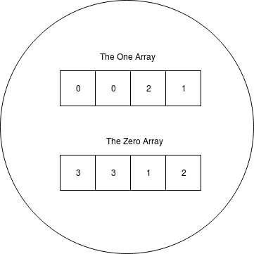
That’s what our node will look like

Slide 36
What about combining the nodes??
Well, simply add the corresponding arrays.
Yup. It’s that easy.

Slide 37

Performing a query is still the same.
Instead of adding two numbers, you’re just adding a couple of arrays.

Slide 38

Here’s a tiny surprise
The problem that we just solved appeared in
CodeChef March Long Challenge DIV 1

Slide 39
I guess that’s it.
Hope you guys had fun :)
Deep Bhattacharyya, Delta Force

